Slide 2
Prolonged Accelerations
Prolonged Deceleration
Presented by : Dr Maryam Zare khafri perinatologist

Slide 3
Accelerations
These are an abrupt FHR increase above the baseline and are defined by the onset-to-peak rise within 30 seconds.
At ≥32 weeks’ gestation, a peaks at a point ≥15 bpm above baseline. Its duration is ≥15 seconds but <2 minutes from onset to baseline return.
Before 32 weeks, a peak ≥10 bpm and duration lasting 10 seconds to 2 minutes is considered normal.
Prolonged acceleration is one lasting ≥2 minutes but <10 minutes.

Slide 4
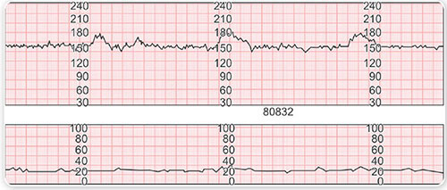
accelerations are represent sympathetic activity and are frequently seen in association with fetal movement.

Slide 5
Accelerations occur antepartum and intrapartum.
Proposed mechanisms for intrapartum accelerations include fetal movement, stimulation by uterine contractions, umbilical cord occlusion, fetal scalp stimulation, scalp blood sampling, and acoustic stimulation.
Accelerations are common during labor, and are virtually always reassuring and almost always confirm that the fetus is not acidemic at that moment
Accelerations reflect intact neurohormonal cardiovascular control mechanisms linked to fetal behavioral states.

Slide 6
accelerations during the first or last 30 minutes of labor were a favorable sign for fetal well-being .
Their absence during labor, however, is not necessarily an unfavorable sign unless coincidental with other Nonreassuring changes.
The chance of acidemia in the fetus that fails to respond to stimulation despite an otherwise Nonreassuring pattern approximates 50 percent

Slide 7
Prolonged Accelerations
accelerations of the FHR occur for a period at least 2 minutes but continue for less than 10 minutes in duration
peak at amplitude of at least 15 bpm above the FHR baseline.
Their distinguishing characteristic, their duration—an interval of between 2 and 10 minutes.

Slide 8
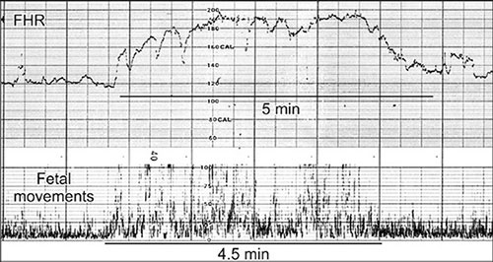

Slide 9
Prolonged Deceleration
Deceleration is ≥ 15 bpm
2min ≤ deceleration < 10min
.absent /decrease variability
.no acceleration
.prompt attention
Fall in FHR lasts 10min,baseline change

Slide 10
Prolonged Deceleration

Slide 11
more common causes:
cervical examination
uterine hyperactivity
cord entanglement
maternal supine hypotension

Slide 12
Prolonged Deceleration
.Epidural, spinal, or paracervical analgesia (1%)
.maternal hypoperfusion or hypoxia
.placental abruption
.umbilical cord knots or prolapse
.maternal seizures (2-10min)
.application of a fetal scalp electrode
.impending birth
.maternal Valsalva maneuver

Slide 13
Prolonged Deceleration
are followed by loss of beat-to-beat variability, baseline tachycardia, and even a period of late decelerations, all of which resolve as the fetus recovers.
Freeman and co-workers (2003) emphasize rightfully that the fetus may die during prolonged decelerations.
Management of isolated prolonged decelerations is based upon bedside clinical judgment, which inevitably will sometimes be imperfect given the unpredictability of these decelerations

Slide 14
management
1-change the maternal position to left lateral
2-increase intravenous fluids
3-stop oxytocic infusion
4-vaginal examination to exclude cord prolapse
5-assess maternal blood pressure(epidural block)
6-fetal blood sample
7-prepare the mother for delivery while the above actions are being
performed

Slide 15
Thanks for your attention

